Slide 1
Particle distribution calibration in two-phase flow using image processing based on sedimentation experiments

Slide 2
Research objectives
The ultimate objective of image processing is to accurately detect the edge of the sediment layer and understand how the layer grows over time by plotting the graph of thickness with respect to time.
The evolution of a sediment layer will be used to calibrate the mean and standard deviation of the particle radii in the two-phase liquid-liquid flow at a given concentration.

Slide 3

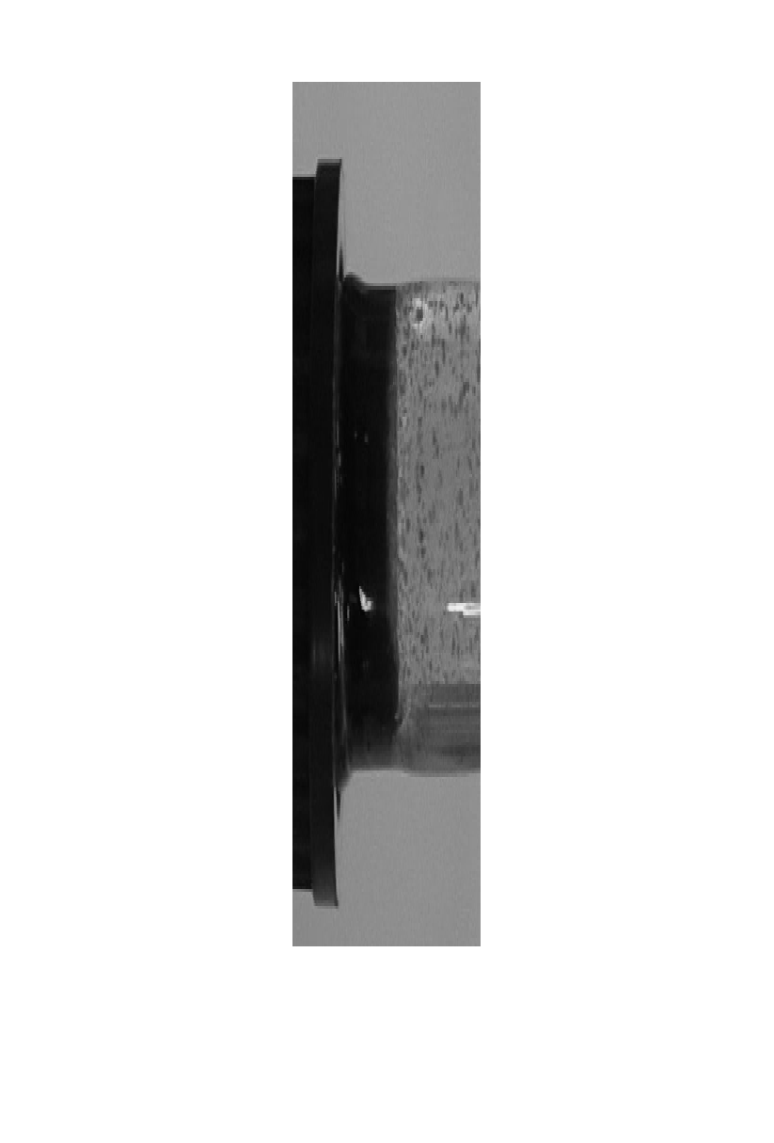
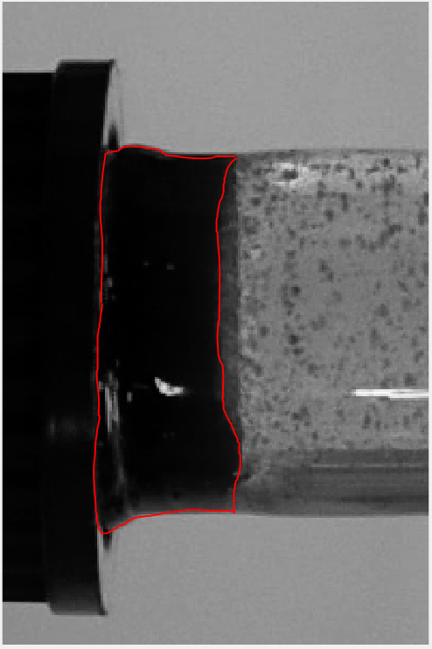
Greyscale Of The Extracted Frame
Original image
Grayscale image
Grayscale image with demarcated edge

Slide 4
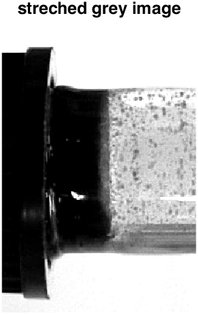
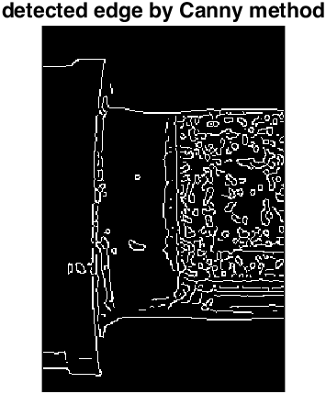
Contrast stretching and edge detection

Slide 5
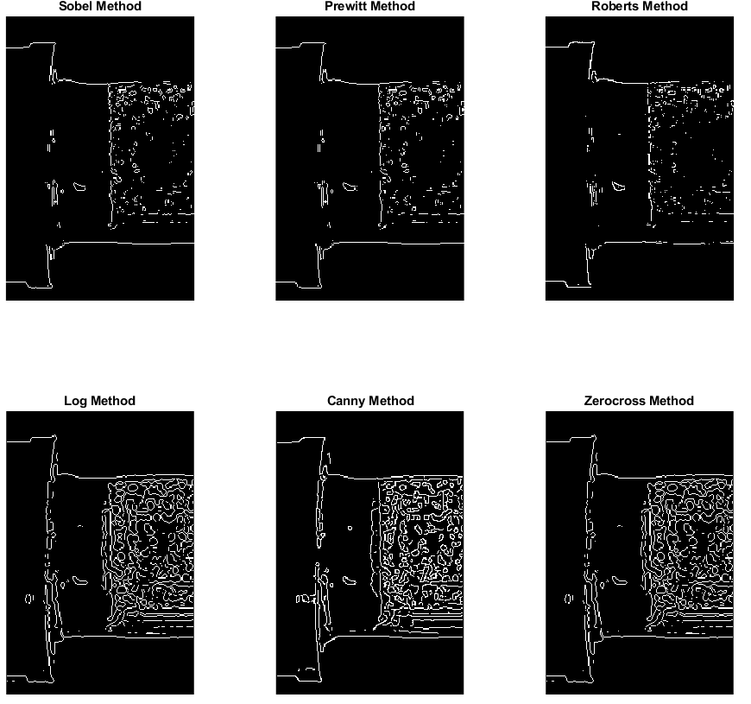
Identified Edges By Different Detectors

Slide 6

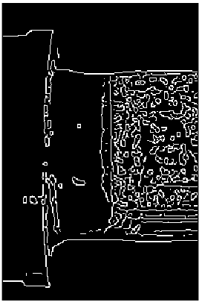
Comparison Between Different Threshold Levels
10%
20%
30%

Slide 7
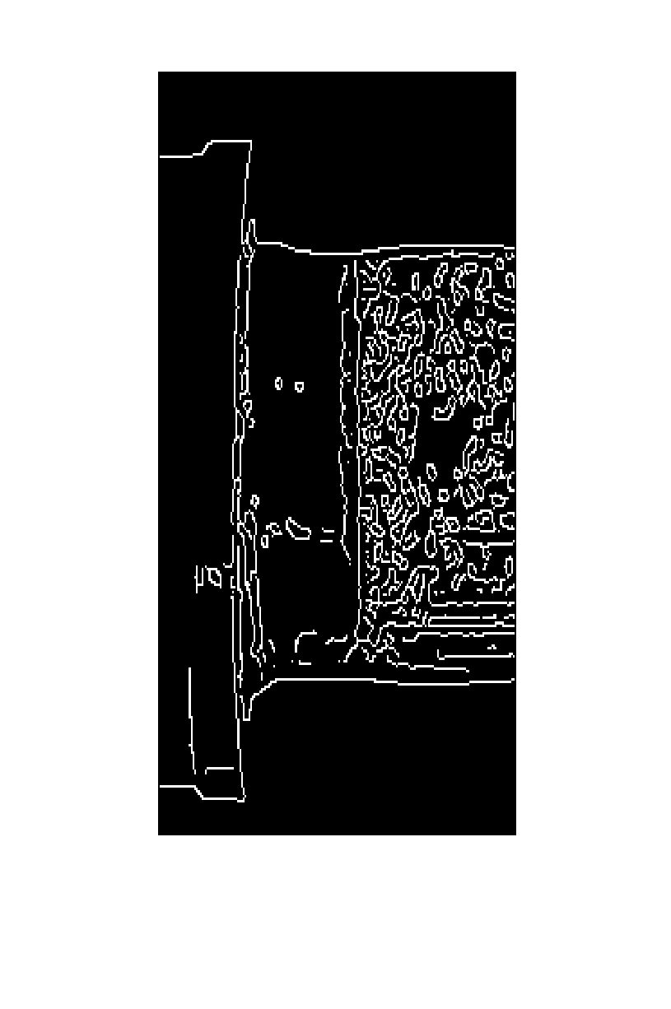
Example Frame With Noises
The dispersed noises may cause imprecision during the thickness measurement stage.
Thus, we need an appropriate filter at the frame where noises are detected

Slide 8
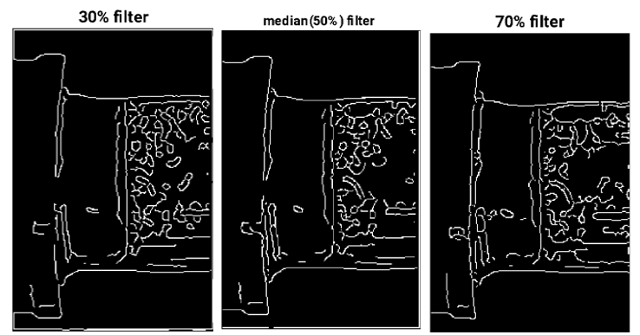
Comparison Between Different Filter Orders

Slide 9
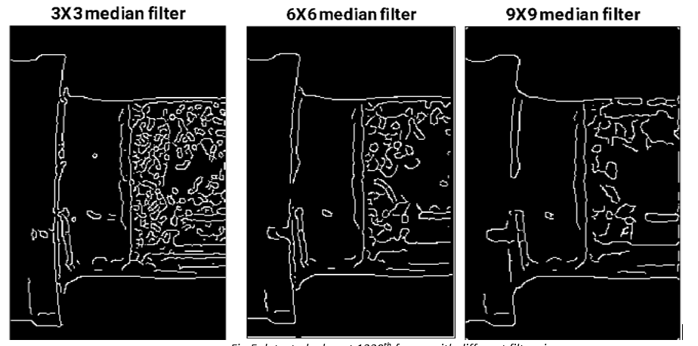
Comparison Between Different Filter Sizes

Slide 10
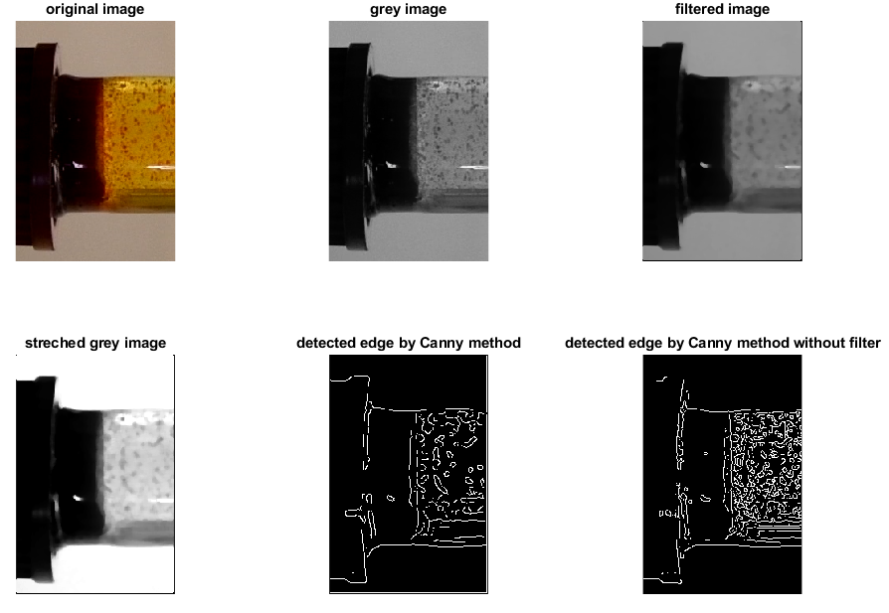
The Full Process Of Edge Detection

Slide 11
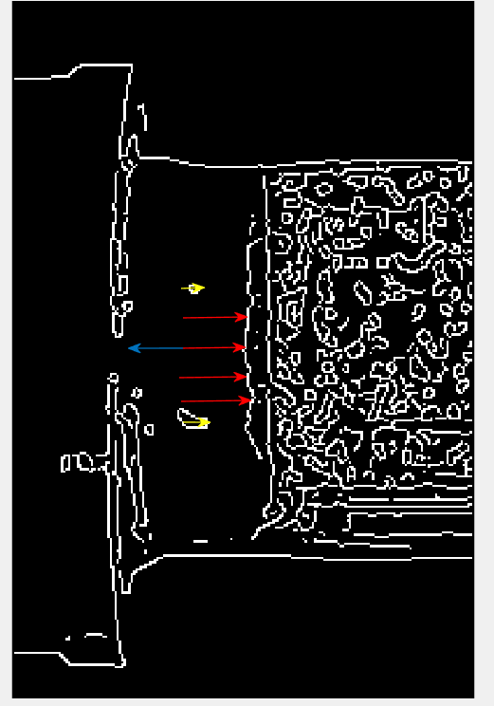
Thickness Measurement and Noise Detection
Thickness samples are indicated by red and yellow arrows, only part of them is illustrated in the image
Detected Noise is indicated by the yellow arrow
The sample will cover a range of 60 pixels during the analysis

Slide 12
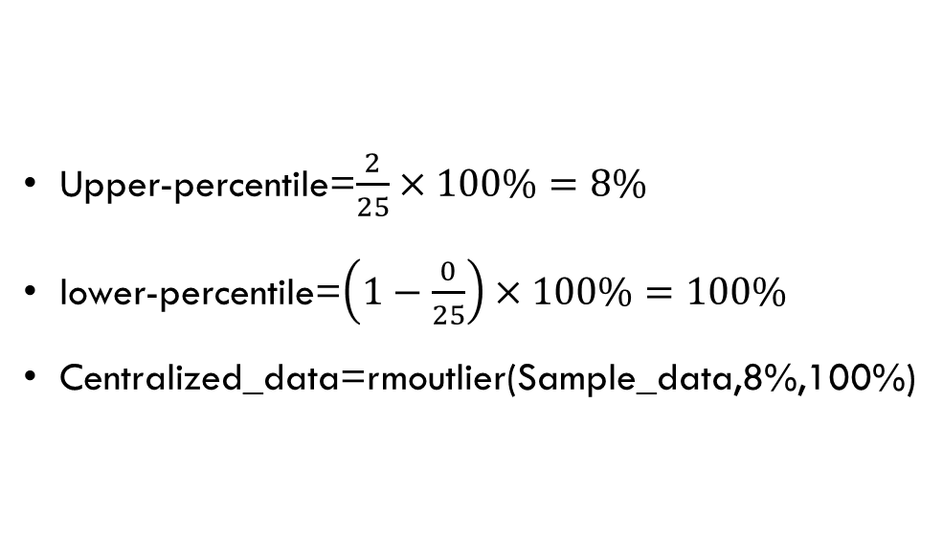
Example of Moving Outliers in MATLAB
Number of sample=25(red and yellow arrows, only part of them is illustrated in the image)
Detected Noise=2 (indicated by yellow arrows)
Detected Jump=0
(Thickness sample which is 5 pixels larger than the mean thickness of the previous frame, we don’t have such jump at this frame)
Upper-percentile=$\frac{2}{25}×100\%=8\%$
lower-percentile=$\left(1−\frac{0}{25}\right)×100\%=100\%$
Centralized_data=rmoutlier(Sample_data,8%,100%)

Slide 13
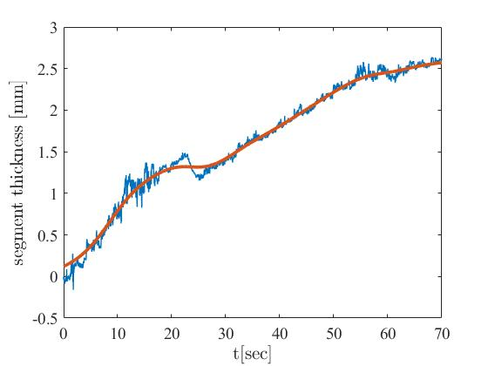
Graph of Thickness vs Time (First Attempt)
30 samples per frame

Slide 14
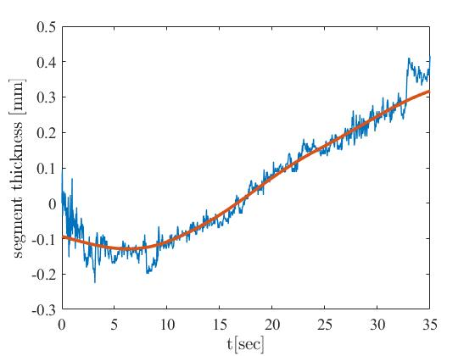
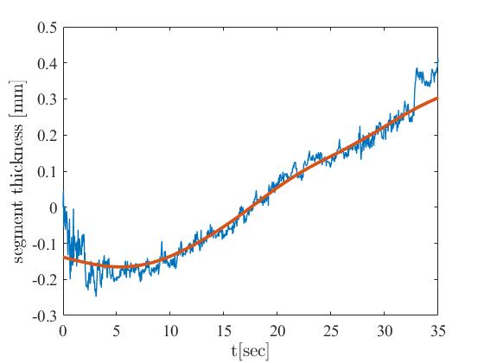
Graph of Thickness vs Time (Second Attempt)
20 samples per frame
30 samples per frame

